Slide 1

Infosys Springboard 4.0 Internship Project (Artificial Intelligence)
Fake News Detection on Social Media Content Using Deep Learning
Presenter:
Yasmeen Shaik

Slide 2
About Dataset and Data Preprocessing
Contents
Problem Statement
Modeling Approach
Models Used and Hyperparameter Tuning
Modelling Results and Future Scope
Presentation Title

Slide 3
Problem Statement
The rapid spread of information through social media platforms has made it increasingly difficult to discern credible news from misinformation. The proliferation of fake news has led to widespread public confusion, undermined trust in legitimate sources, and posed significant risks to public health and safety. To address this, artificial intelligence, particularly deep learning, offers a promising solution. Here we aim to develop a deep learning model to detect and filter out false information from digital platforms by analyzing textual content and this will help identify misleading information, and protect the public from the adverse effects of misinformation.

Slide 4




Business Use Cases
Reputation Management
- Protecting Brand Reputation
- Crisis Management
Public Safety and Awareness
Emergency Response
Health Information
Advertising and Marketing
Targeted advertising
- Campaign effectiveness
Content Moderation
- Ensuring Platform Integrity
- Building User Trust

Slide 5
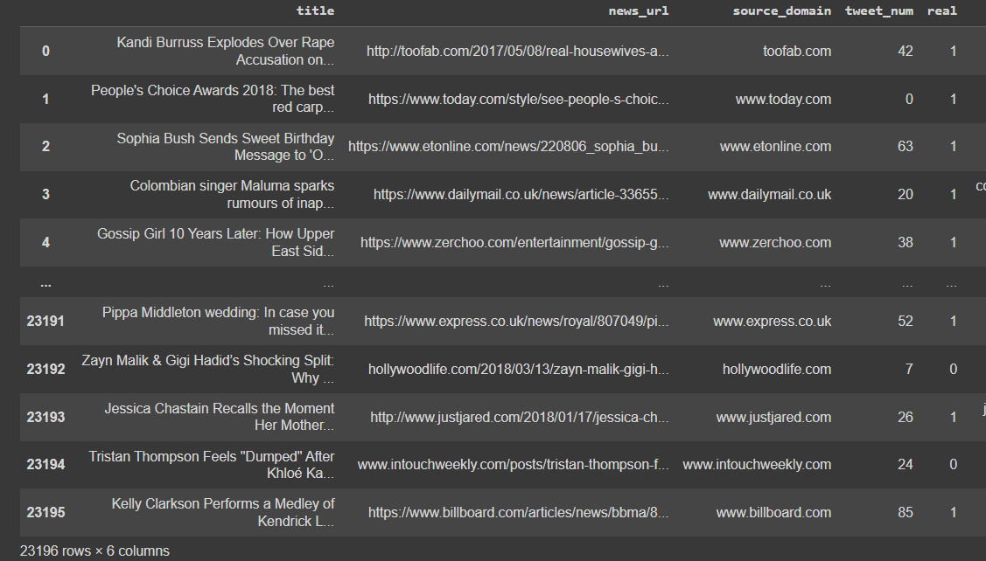
Overview of Dataset

Slide 6
Data Preprocessing
Data Preprocessing Steps:
Convert to Lower Case: Standardize text by converting all characters to lower case.
Contraction Splitting: Expand contractions (e.g., "don't" to "do not").
URL Removal: Remove hyperlinks from the text.
Remove New Lines: Eliminate newline characters (\n) from the text.
Remove Words Containing Numbers: Discard words that contain numerical characters.
Remove Extra Spaces: Trim unnecessary spaces from the text.
Remove Special Characters: Exclude punctuation and other special characters.
Stop Words Removal: Remove common stop words (e.g., "and", "the").
Lemmatization: Reduce words to their base or root form.

Slide 7
Modeling Approach
Project work flow
Feature Engineering
Training Models
Data Preprocessing
Result Analysis

Slide 8
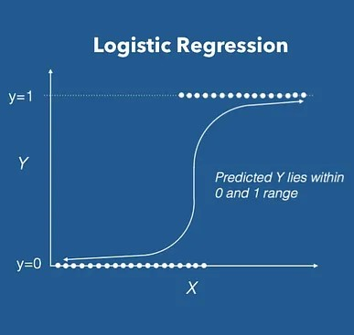
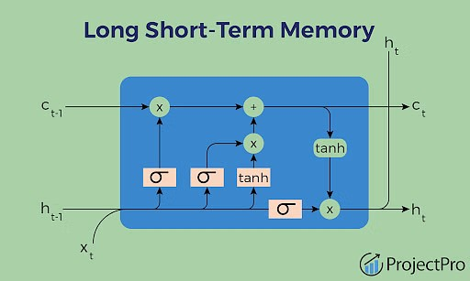
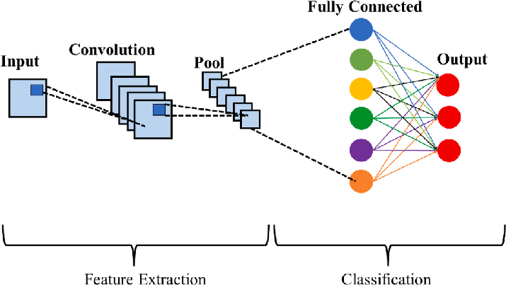
Models Build and Hyperparameter Tuning
Hyperparameter tuning helps us to find the best scoring model with suitable parameters.
Used GridSearchCV for the tuning.
Logistic Regression
CNN (Convolutional Neural Network)
LSTM (Long Short-Term Memory)

Slide 9
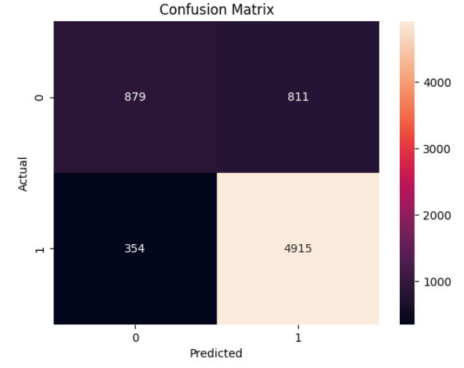
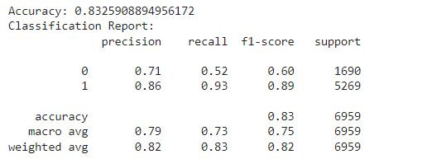
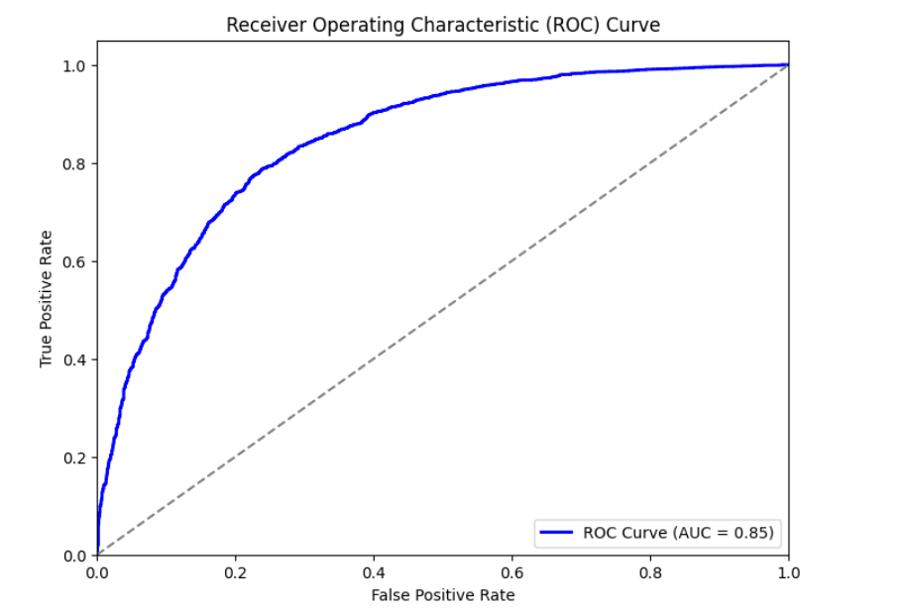
Model Results and Future Scope
Logistic Regression Results

Slide 10
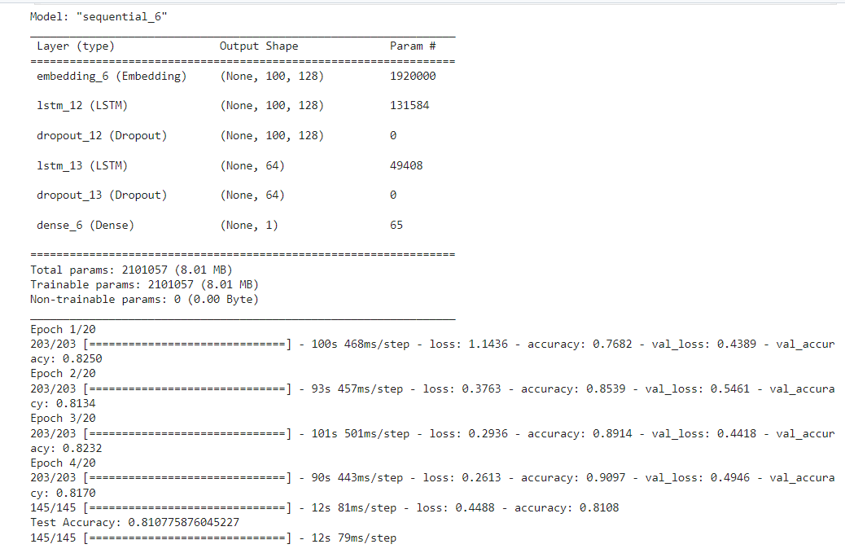
LSTM Results

Slide 11
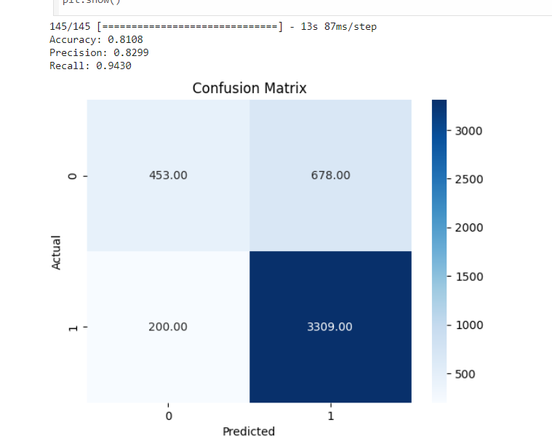
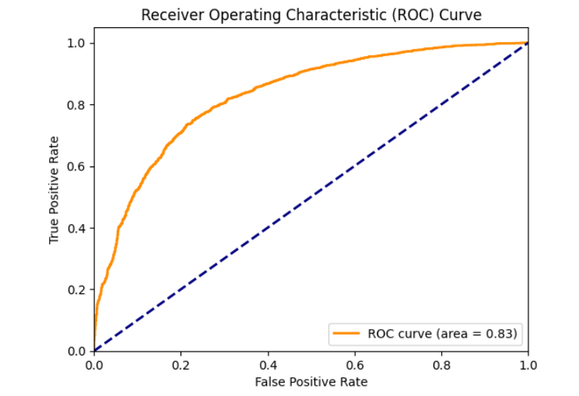

Slide 12
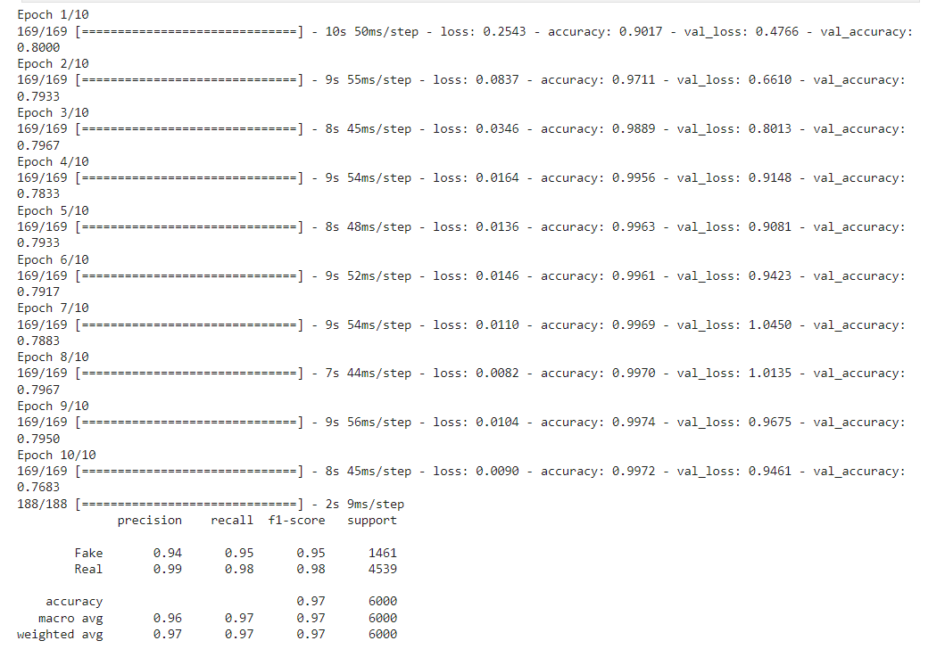
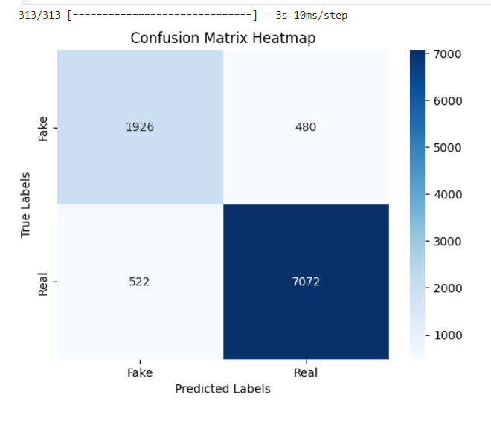
CNN Results

Slide 13
Best Model of the three Models
The Convolutional Neural Network stands out as the best-performing model based on performance metrics when compared with the other two models that are built i.e., LSTM and Logistic Regression.

Slide 14
Future Scope
Model Enhancements
Ensemble methods
Transfer learning
Regular Updates and Maintenance
Model retraining
Algorithm optimization
Ethical Considerations
Bias mitigation
Privacy and security
Scalability and Deployment
Scalable solutions
Cloud integration

Slide 15
Thank you
Thank you Infosys Springboard for the wonderful opportunity to show case our work!

